Slide 1

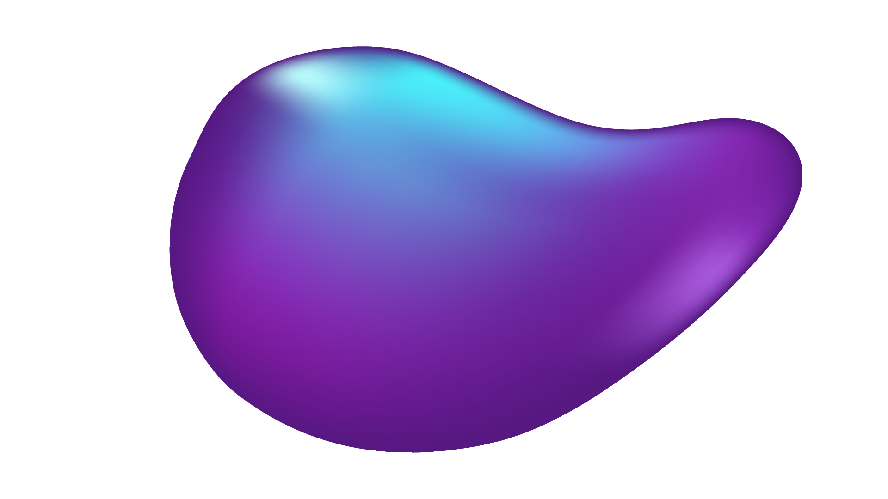
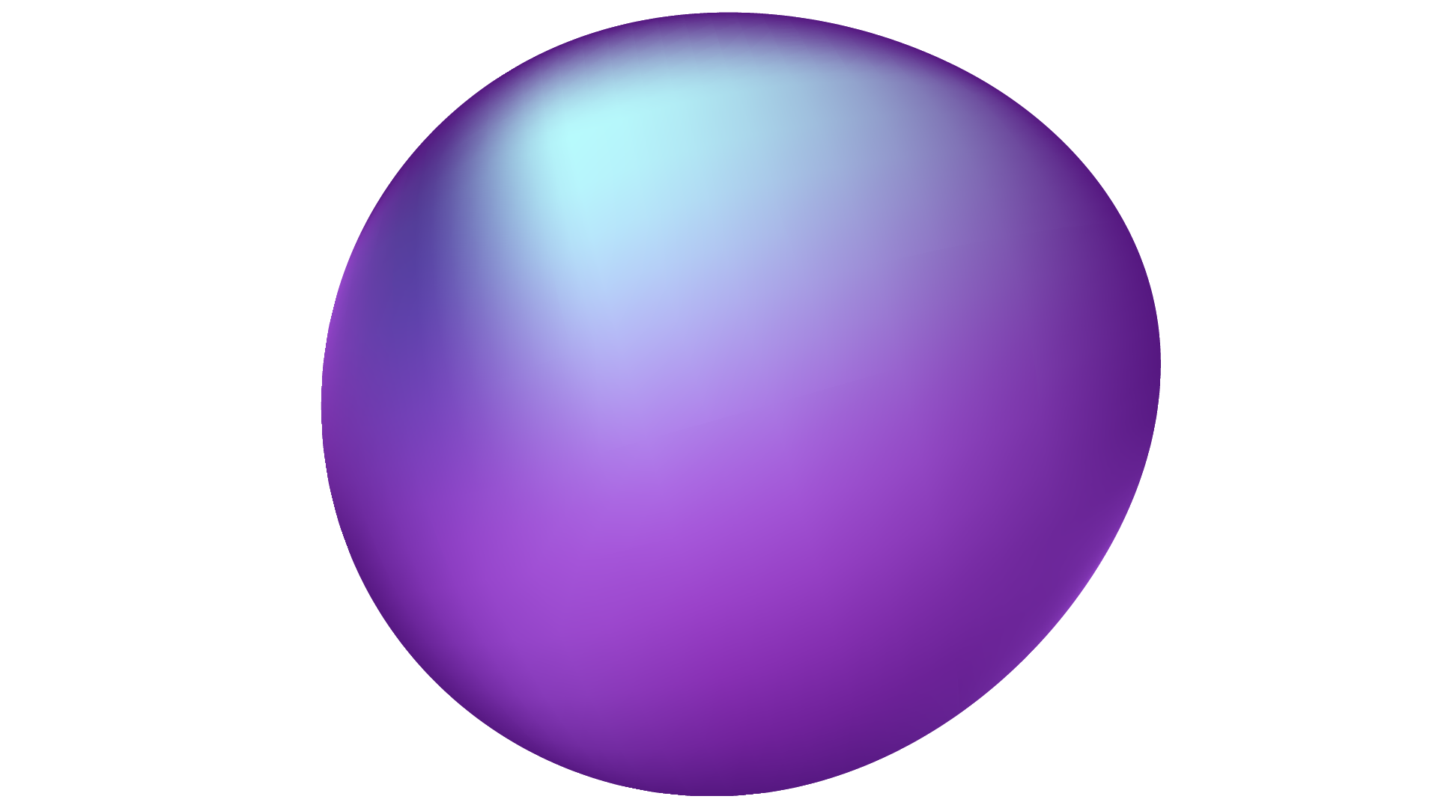
TOXIC COMMENT CLASSIFICATION
PROJECT
By Pierre Kachi 232732

Slide 2
TABLE OF CONTENTS
01
02
03
04
INTRODUCTION
DATA COLLECTION AND PRE-PROCESSING
MODEL TRAINING AND RESULTS
API AND DOCKER
05
CONCLUSION

Slide 3
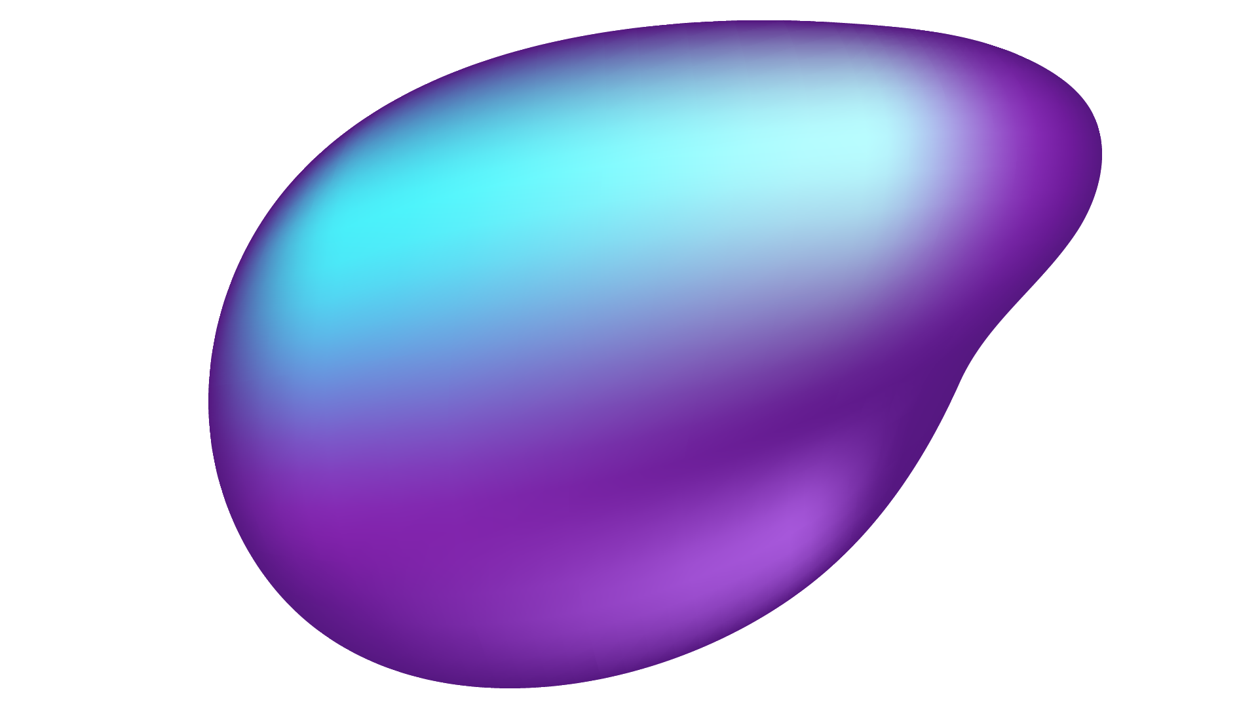

01
INTRODUCTION

Slide 4
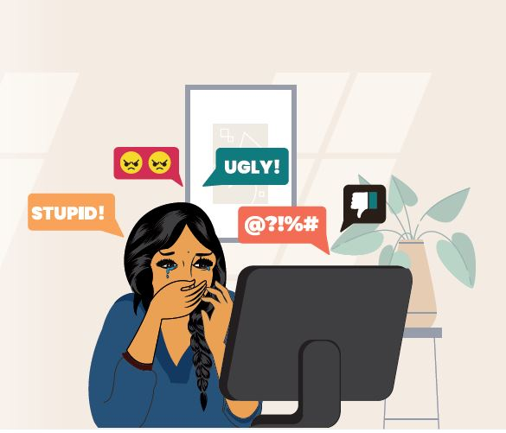
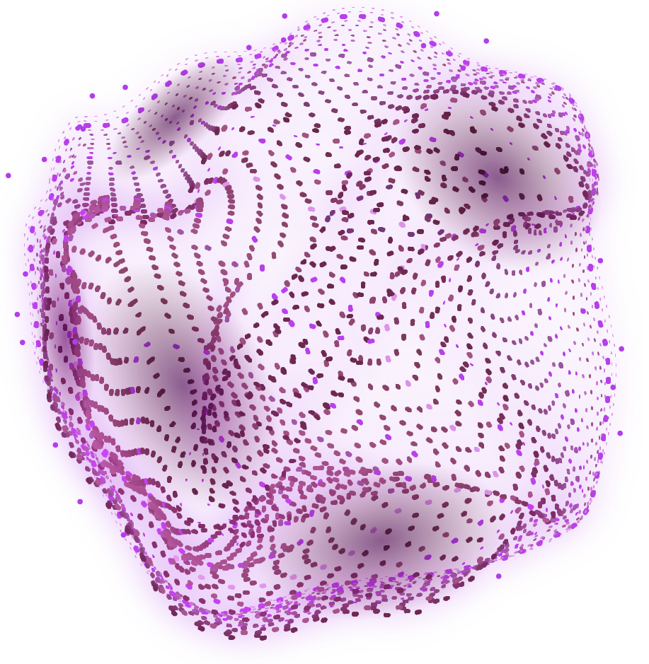
PROBLEM
In today's digital age, where online communication is omnipresent, the need for a secure and inclusive virtual environment is paramount. Yet the number of ill-intentioned individuals, from simple internet trolls to targeted defamation campaigners, has never been higher

Slide 5

SOLUTION
Be it companies who want to keep their reputations clean, group chat moderators and even worried parents who’d like to make sure their kids aren’t getting targeted, everyone could make use of an automated toxicity detector. We have therefore created an AI model that is capable of rating any text under 1800 characters, on 6 different scales, from general toxicity to ethnic hate, through the power of AI!

Slide 6
02
DATA COLLECTION AND PRE-PROCESSING

Slide 7
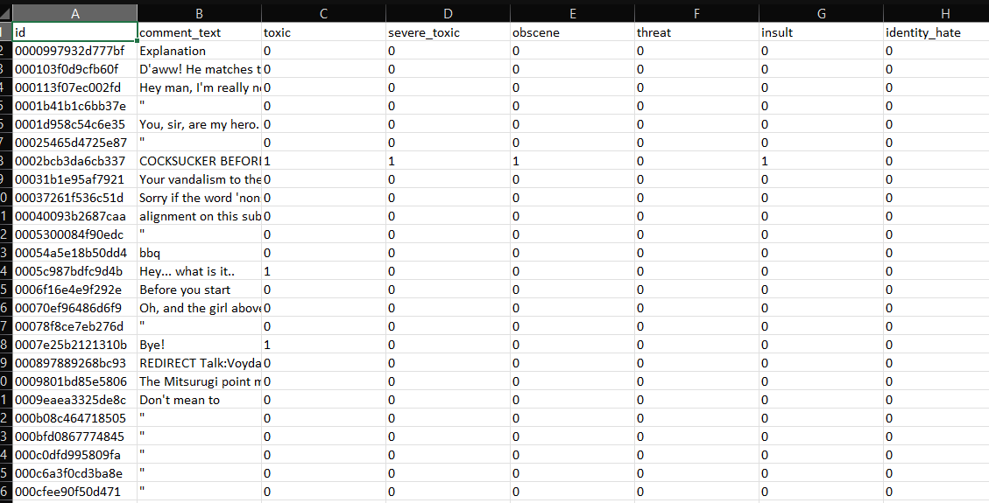
DATA SHAPE
Our chosen dataset contains a large amount of comment texts, each being assigned 6 representing levels of toxicity ranging from plain toxic to identity hate

Slide 8
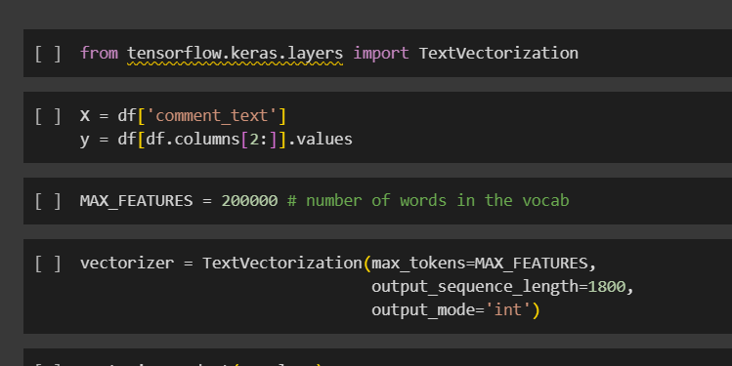
VECTORIZATION
Definition:
Vectorization involves the conversion of textual data into numerical vectors, which are mathematical representations suitable for machine learning algorithms. Each tokenized word or phrase is assigned a unique numerical value within the vector.
Purpose:
Vectorization is crucial for machine learning models because these models operate on numerical data. By representing text as numerical vectors, the model can extract patterns, relationships, and semantic meanings from the data.

Slide 9
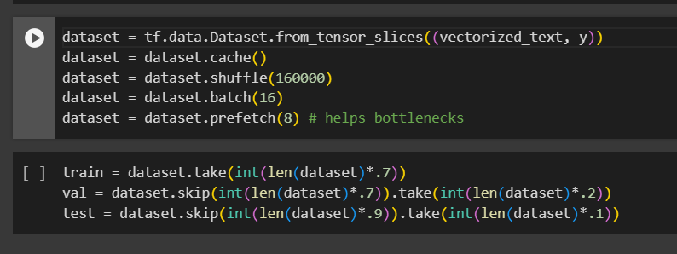
PIPELINE OPTIMIZATIONS AND SPLITTING
Now that the computer can understand our texts, we can start fixing up our dataset:
We first slice a pair of data (vectorized_text and y) into smaller pieces. Then, we cache the dataset for faster access, shuffle it to enhance training, batches it into groups of 16 samples, and prefetch 8 batches ahead to optimize processing speed, especially during bottlenecks.
Now that our data is ready we split it into 70% training, 20% validation and 10% testing.

Slide 10
03
MODEL TRAINING AND RESULTS

Slide 11
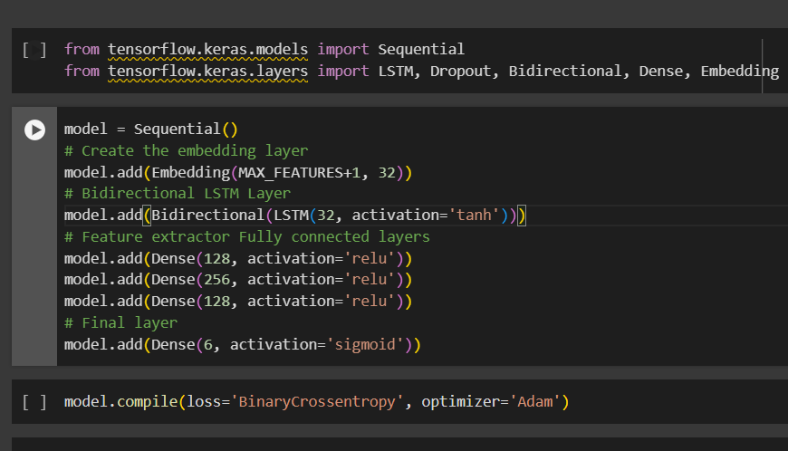
SEQUENTIAL DEEP LEARNING MODEL
Embedding Layer: Converts words to 32-dimensional vectors.
Bidirectional LSTM Layer: Captures contextual information in both directions.
Dense Layers (128, 256, 128): Extract features using ReLU activation.
Final Dense Layer (6 units): Produces multi-label classification probabilities.
The Embedding layer converts word indices to dense vectors.
Bidirectional LSTM processes sequences bidirectionally for context understanding.
Dense layers further refine features extracted by the LSTM.
The final Dense layer outputs probabilities for the six classification classes.

Slide 12
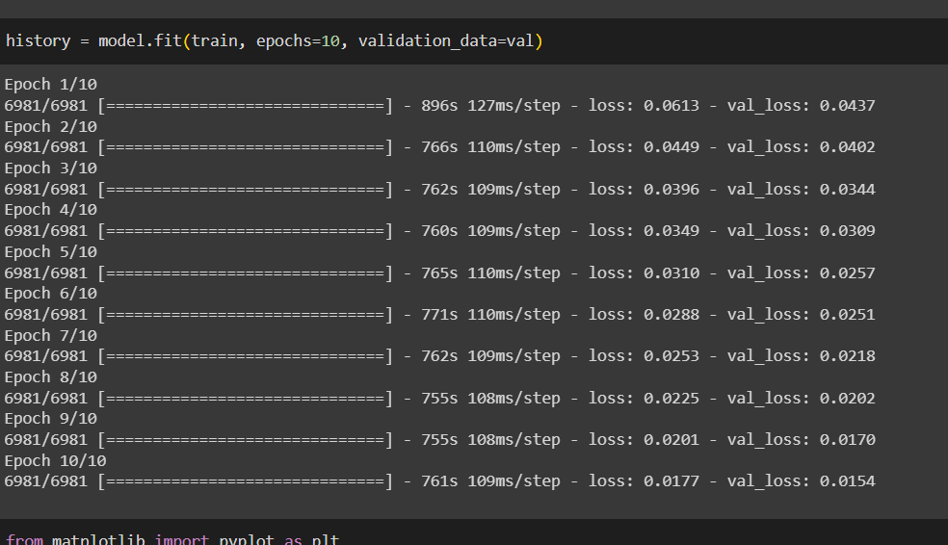
MODEL FITTING
We then trained our model for 10 epochs which took about 2 hours. Our final loss was of 0.0177 and final validation loss was of 0.0154

Slide 13
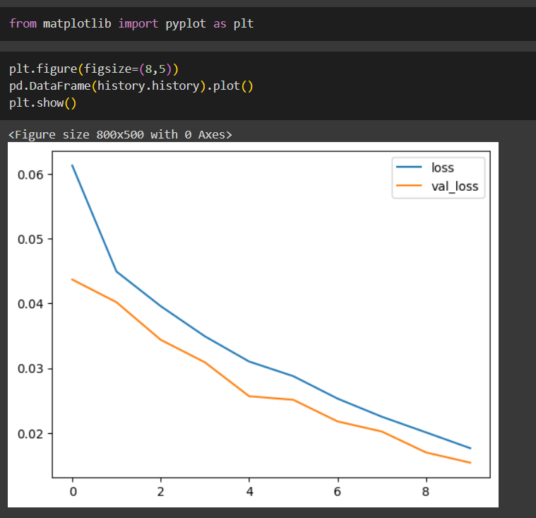
RESULTS
As can be seen from this plot, our model could have gained much from further training, however free tier google colab and time constraints, we could not reach convergence, however our results still remain relatively satisfactory as will be seen in the following slides

Slide 14
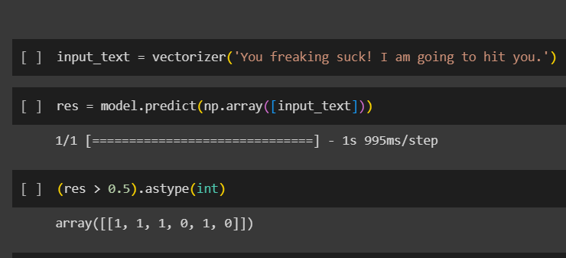
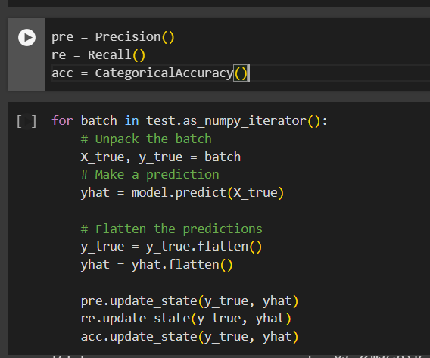
SCORE AND INFERENCE
This image shows inference using a random sentence, while considering any score above 0.5 to be toxic.
This next image shows code which evaluates a machine learning model using precision, recall, and categorical accuracy metrics. It iterates through batches in the test dataset, unpacks input and true labels, makes predictions using the model, flattens the predictions and true labels to match, and then updates the states of Precision, Recall, and CategoricalAccuracy objects with the true and predicted values. This allows the metrics to accumulate and reflect the overall performance of the model on the test dataset.

Slide 15
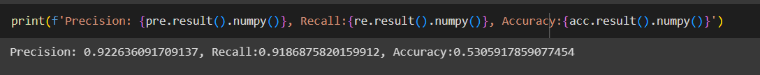
SCORE AND INFERENCE
As can be seen above, we managed to achieve a precision matrix of over 92%, a recall metric of over 91% and an accuracy metric 53%

Slide 16
04
API AND DOCKER

Slide 17
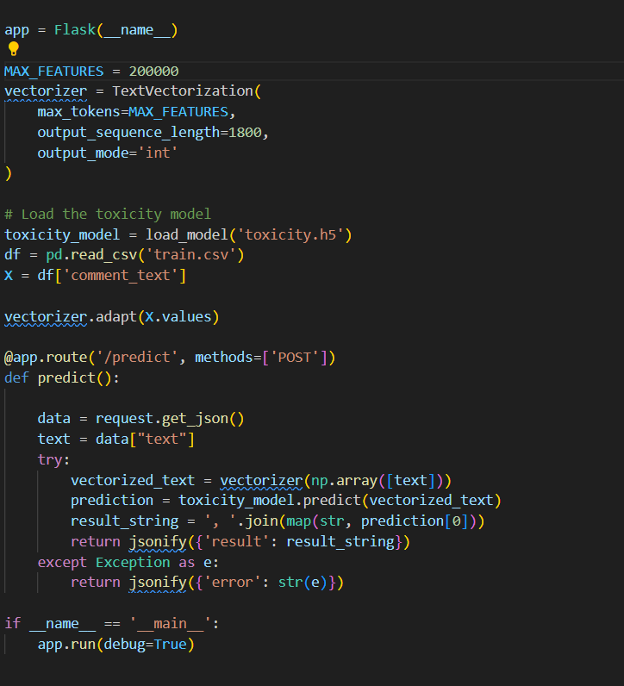
API
This app uses a simple API ("/predict") to receive a JSON input containing text, preprocesses it using the TextVectorization model with the same parameters used during our model training, predicts toxicity using our loaded model, and returns the prediction results as a JSON response. The app runs locally when executed.

Slide 18
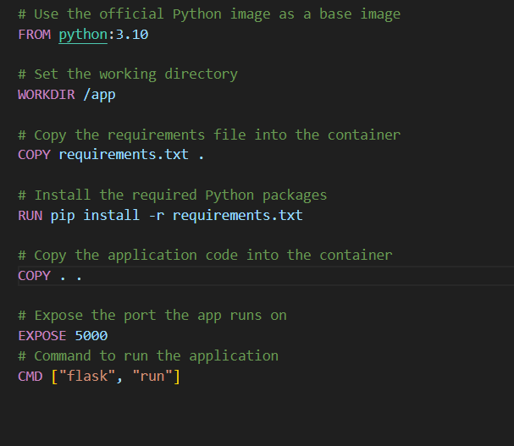
DOCKER
Here is our docker image’s configuration, we are simply uploading the contents of our app folder in the image and running the code, while also exposing port 5000 to confirm its availability

Slide 19
05 Conclusion
Though our model still needs refinement, we truly believe in the potential of this technology and the good it could bring, be it b2b it b2c. THANK YOU!

